Slide 1
GAC 175: BIOLOGICAL CHEMISTRY
Dr Amma Larbi

Slide 2
ACID AND BASES
Amma Larbi, PhD
1

Slide 3
FOCUS
This lecture will focus on;
The various concepts/theories on acids and bases
How to calculate pH and acid/base dissociation constants
How to determine the strength of acids and bases
Measurement of pH
Buffers and their mode of operation
How to calculate the pH of buffers and buffer capacity
The mechanism of some physiological buffers

Slide 4
THREE CORE CONCEPTS
Arrhenius Concept
Bronsted-Lowry Concept
Lewis Concept
2

Slide 5
Arrhenius Concept
An acid is a substance that releases hydrogen ions (H⁺) when dissolved in water
HCl_{(aq)}→H⁺_{(aq)} + Cl⁻_{(aq)}
A base is a substance that releases hydroxide ions (OH⁻) when dissolved in water
NaOH_{(aq)}→Na⁺_{(aq)} + OH⁻_{(aq)}
Limitations
1. Applies to water only (Free OH⁻ and H⁺ do not exist in water)
H⁺ forms H₃O⁺
OH⁻ forms H₃O₂⁻
2. Some bases do not contain OH⁻
Ammonia (NH₃)
Calcium oxide (CaO)
2

Slide 6
Bronsted-Lowry Concept
An acid is a molecule or ion that can donate a proton (H⁺)
A base is a molecule or ion that can accept a proton
This concept identifies acids and bases as conjugate pairs.
Consider a reaction
Acid₁ + Base₂ → Acid₂ + Base₁
HCl + H₂O ⇔ H₃O⁺ + Cl–
NH₃ + H₂O ⇌ NH₄⁺ + OH⁻
NH₃ = base (accepts H⁺)
H₂O = acid (donates H⁺)
2

Slide 7
A strong acid easily gives away protons to a base to form a weak conjugate base while a strong base will accept the proton more easily to from a weak conjugate acid
The formation of conjugate pairs are important in the considerations of buffers and buffer mechanisms
2

Slide 8
LEWIS CONCEPT
An acid is an electron pair acceptor
A base is an electron pair donor
Lewis acid and base share the electron pair provided by the base creating a covalent bond (or coordinate bond) between them. The resulting combination is called a Complex
BF₃ + NH₃ → F₃B←NH₃
BF₃ = Lewis acid (electron-deficient)
NH₃ = Lewis base (lone pair donor)

Slide 9
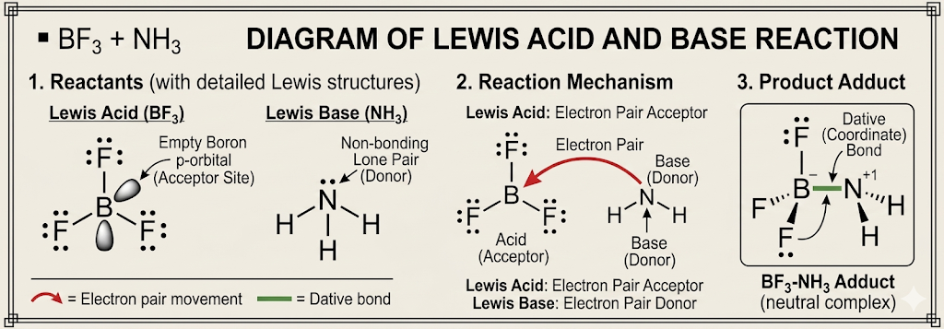
According to the theory, the process of neutralization is simply the formation of a coordinate bond between an acid and a base

Slide 10
Relative Strength of Acids and Bases
The strength of an acid or base is not about the number of protons (monoprotic or polyprotic).
It is about how easily it behaves as an acid or base.
Acid strength = how easily it donates H⁺ (protons).
Base strength = how easily it accepts H⁺ (protons). The strength of acids and bases can change depending on their environment (e.g., solvent, surrounding conditions).

Slide 11
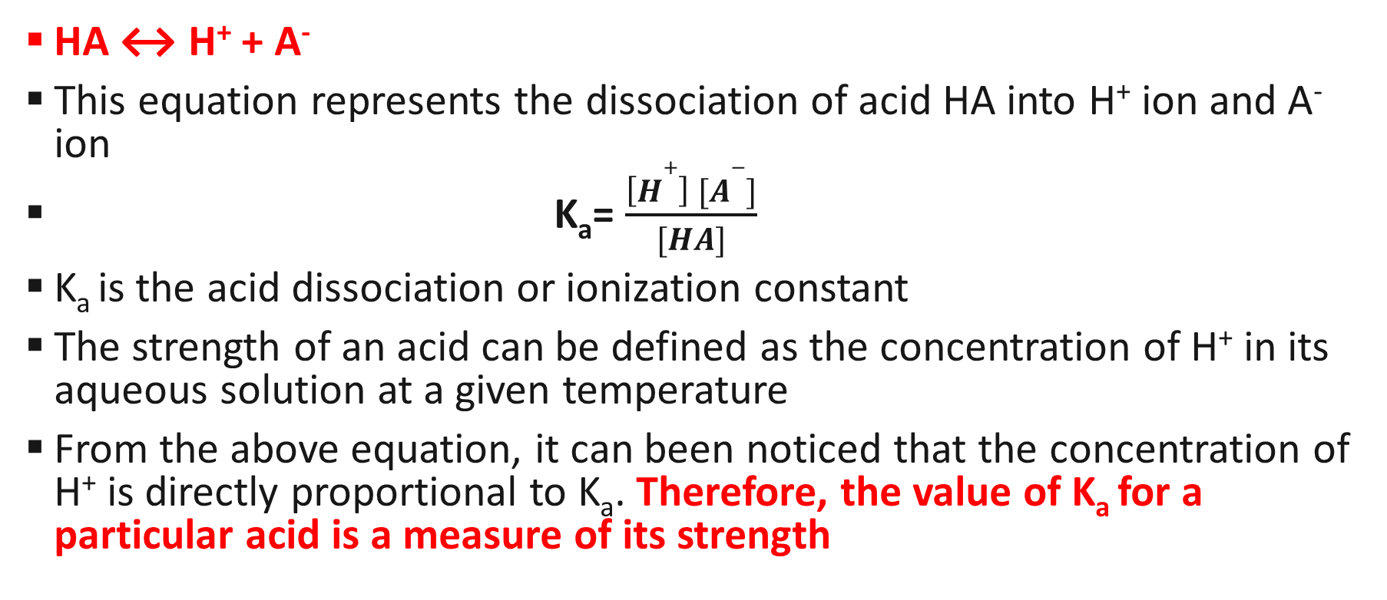
Calculating Strength of Strong Acids
HA ↔ H⁺ + A⁻
This equation represents the dissociation of acid HA into H⁺ ion and A⁻ ion
K_{a}= $\frac{\left[H+\right] [A−]}{[HA]}$
K_{a} is the acid dissociation or ionization constant
The strength of an acid can be defined as the concentration of H⁺ in its aqueous solution at a given temperature
From the above equation, it can been noticed that the concentration of H⁺ is directly proportional to K_{a}. Therefore, the value of K_{a} for a particular acid is a measure of its strength

Slide 12
Strength of Strong Acids
HA ↔ H⁺ + A⁻
This equation represents the dissociation of acid HA into H⁺ ion and A⁻ ion
K_{a}= $\frac{\left[H+\right] [A−]}{[HA]}$
K_{a} is the acid dissociation or ionization constant
The strength of an acid can be defined as the concentration of H⁺ in its aqueous solution at a given temperature
From the above equation, it can been noticed that the concentration of H⁺ is directly proportional to K_{a}. Therefore, the value of K_{a} for a particular acid is a measure of its strength

Slide 13
Strong acids dissociate fully in water, resulting in a large Ka value
In contrast, weak acids only partially break apart in water, which results in a low Ka value
Thus, in general, the value of the acid dissociation constant is large for a strong acid and small for a weak acid
Since strong acids fully dissociate in water, the concentration of hydrogen ions (H⁺) is identical to the initial concentration of the acid. For instance, a 0.1 M solution of HCl yields exactly 0.1M of H⁺
Because weak acids like ethanoic acid only partially break apart, the concentration of free H⁺ ions will always be much smaller than the original concentration of the acid."

Slide 14
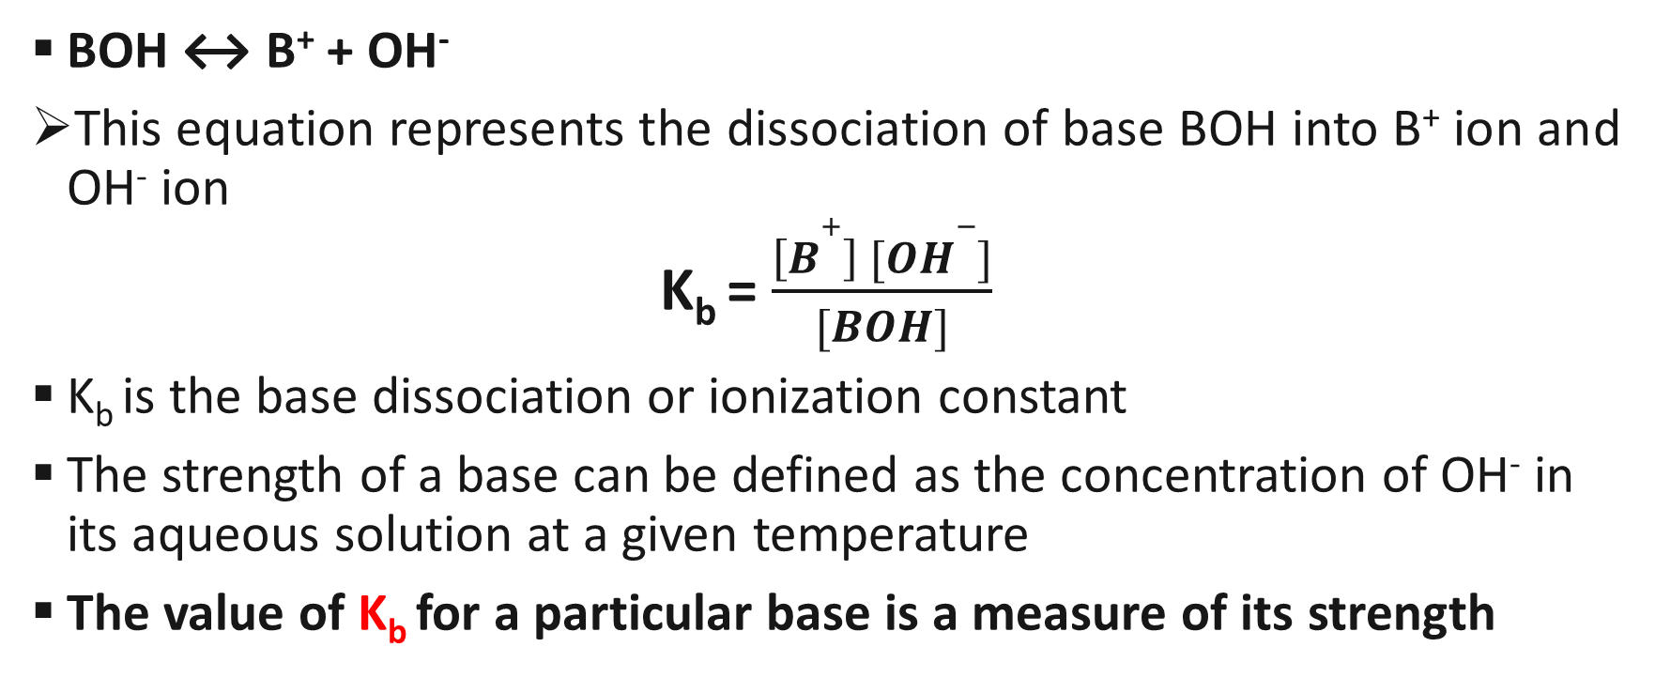
Strength of a Base
BOH ↔ B⁺ + OH⁻
This equation represents the dissociation of base BOH into B⁺ ion and OH⁻ ion
K_{b} = $\frac{\left[B+\right] [OH−]}{[BOH]}$
K_{b} is the base dissociation or ionization constant
The strength of a base can be defined as the concentration of OH⁻ in its aqueous solution at a given temperature
The value of K_{b} for a particular base is a measure of its strength

Slide 15
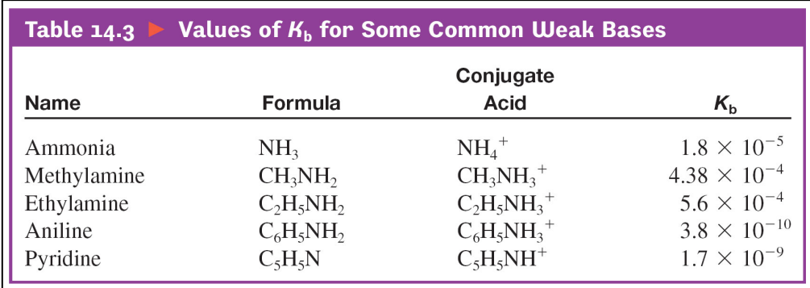
Values of Kb for some common Weak bases

Slide 16
Factors that influence the strength of acids and bases
The polarity of the bond to which the hydrogen or hydroxyl atom is attached
The strength of the bond

Slide 17
Calculating acidity and basicity
Since the amounts of H⁺ and OH⁻ in water are usually very small, a simpler way of measuring them was created, called pH.
pH is the method of expressing the concentration of hydrogen or hydronium ions in a solution
It may be expressed as pH = - log [H⁺]
pOH is the method of expressing the concentration of hydroxide ions in a solution
It may be expressed as pOH = - log [OH⁻]

Slide 18
Since K_{w} = [H⁺] [OH⁻], pK_{w} = - log K_{w}
= -log (1.0 × 10⁻¹⁴) =14
Hence pH + pOH =14

Slide 19
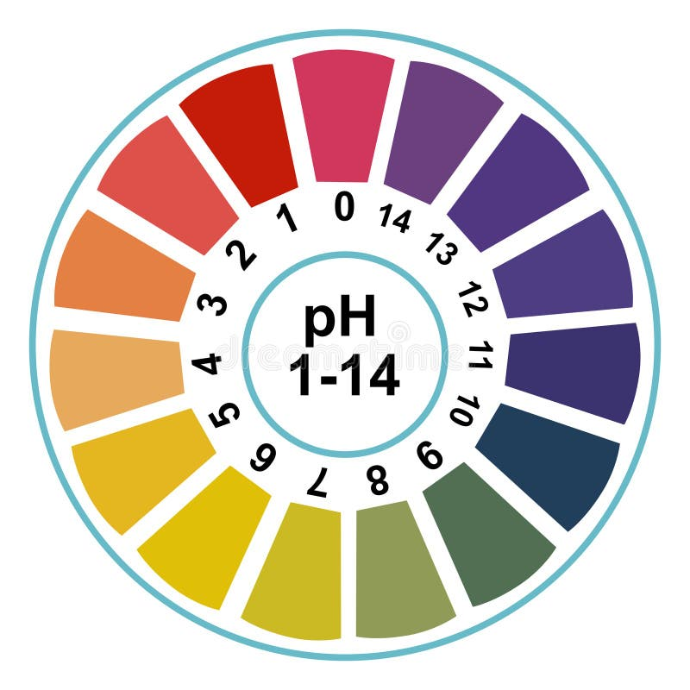
Measurement of pH
There are several ways of measuring pH of a solution.
Addition of pH indicator to solution
Using a pH or indicator paper that changes colour in correspondence to the colours on a colour key

Slide 20
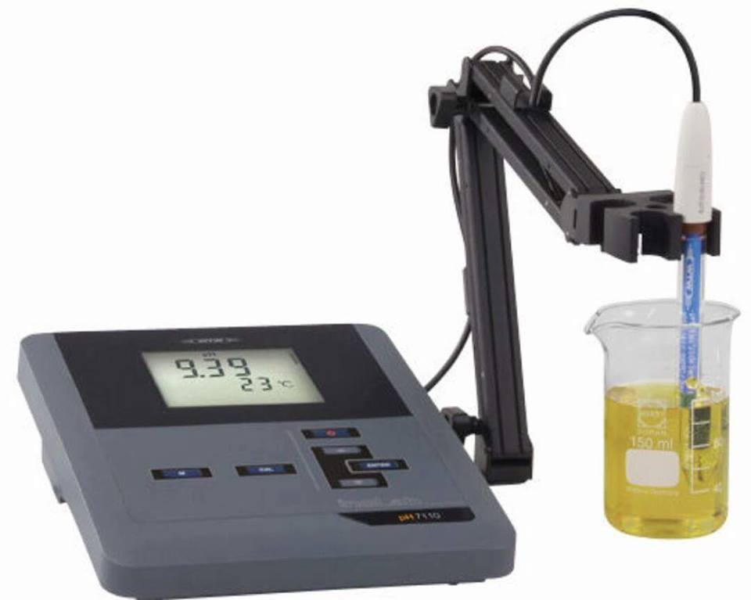
Using a pH meter

Slide 21
Importance of Acids and Bases
Acid-base reactions are used to create or modify salts for effervescent formulations.
They are used in analytical procedures, i.e., titration
They are used as therapeutic agents in the control of and adjustment of the pH of GIT, body fluid and urine

Slide 22
Isomerism

Slide 23
Objectives:
By the end of this topic, you should have learnt the following;
Structural or constitutional isomerism
Geometric isomerism
Optical isomerism

Slide 24
Introduction
It is a common feature to come across compounds with the same molecular formula but with different physical and chemical properties
These differences in properties may be slight or very remarkable
The reason for the difference is may be due to how the constituents atoms may be linked to each other or how they are arranged in the 3-D space
Isomerism therefore is a situation where compounds having the same molecular formula can be represented by different structures

Slide 25
Types of Isomerism
There are two primary types of isomerism, which can be further categorized into different subtypes.
These primary types are Structural Isomerism and Stereoisomerism. The classification of different types of isomers is illustrated below.

Slide 26
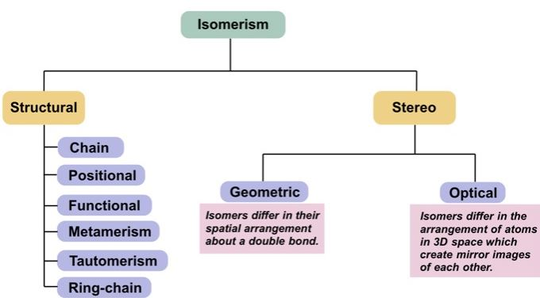

Slide 27
Structural Isomerism
Structural isomerism is commonly referred to as constitutional isomerism. The functional groups and the atoms in the molecules of these isomers are linked in different ways.
Different structural isomers are assigned different IUPAC names since they may or may not contain the same functional group.
Several forms of constitutional isomers
Chain isomers
Positional isomers
Functional group isomers
Tautomers etc

Slide 28
Chain Isomerism
It is also known as skeletal isomerism.
The components of these isomers display differences in the way atoms are arranged as straight chains or as branched compounds
Commonly, chain isomers differ in the branching of carbon
An example of chain isomerism can be observed in the compound C₅H₁₂, as illustrated below.

Slide 29
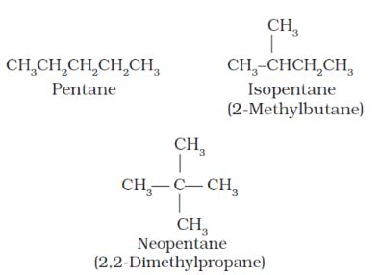

Slide 30
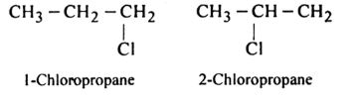
Positional Isomerism
The positions of the functional groups or substituent atoms are different in position isomers.
Typically, this isomerism involves the attachment of the functional groups to different carbon atoms in the carbon chain.
An example of this type of isomerism can be observed in the compounds having the formula C₃H₇Cl

Slide 31
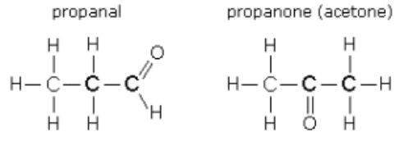
Functional Isomerism
It is also known as functional group isomerism.
As the name suggests, it refers to the compounds that have the same chemical formula but different functional groups attached to them.
An example of functional isomerism can be observed in the compound C₃H₆O

Slide 32
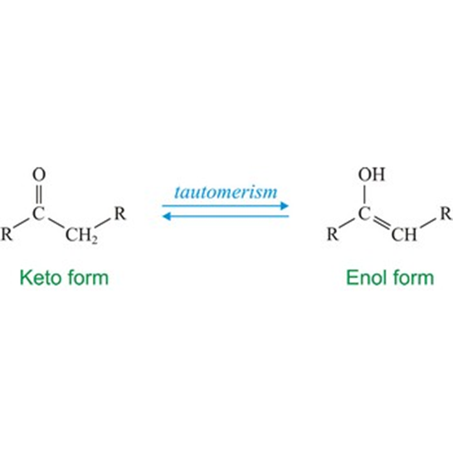
Tautomerism
A tautomer of a compound refers to the isomer of the compound which only differs in the position of protons and electrons.
Typically, the tautomers of a compound exist together in equilibrium and easily interchange.
It occurs via an intramolecular proton transfer.
An important example of this phenomenon is Keto-enol tautomerism.

Slide 33
Stereoisomerism
This type of isomerism arises in compounds having the same chemical formula but different orientations of the atoms belonging to the molecule in three-dimensional space.
The compounds that exhibit stereoisomerism are often referred to as stereoisomers. This phenomenon can be further categorized into two subtypes.

Slide 34
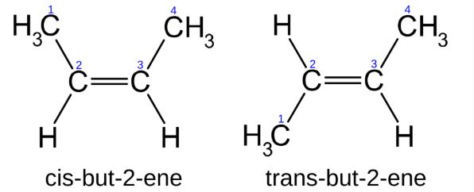
Geometric Isomerism
This type of isomerism is due to hindered rotation about a double bond system or a ring system. The presence of c=c introduces remarkable rigidity in the molecule
It is popularly known as cis-trans isomerism. These isomers have different spatial arrangements of atoms in three-dimensional space.
An illustration describing the geometric isomerism observed in the acyclic But-2-ene molecule is provided below

Slide 35
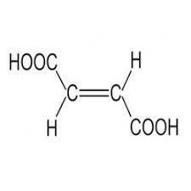
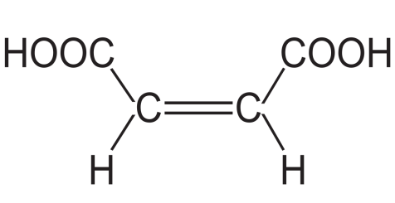
Note that as a result of the double bond, it is not possible to obtain the cis from the trans just by rotating one of the doubly bonded carbons as it may appear so. Therefore the two isomers are two different compounds with different physical properties
Apart from the double bond for an alkene to show geometric isomerism, the groups attached to the doubly bonded carbon atoms should be different .Cis-trans isomers differ in stability, boiling point and melting point
Take cis- butanedioic acid (maleic acid) and trans butanedioic acid (fumaric acid) for instance
Fumaric acid
Maleic acid

Slide 36
With the COOH groups being so close in the cis-isomer, there can be interaction between them, leading to the elimination of water to form a ring anhydride
The cis isomer can lose water at about 150ºC to form the anhydride which can readily be reconverted to the cis-isomer in the presence of water. The trans isomer cannot form such anhydride
In living cells, there can be hydration of fumaric acid in a reaction catalysed by and enzyme called fumarase.
The enzyme fumarase is sterospecific for fumaric acid but not the cis

Slide 37
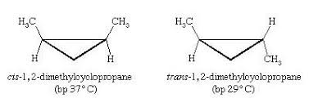
A similar situation can be seen in ring structures where the ring introduces molecular rigidity and causes geometric isomerism

Slide 38
Optical Isomerism
Compounds that exhibit optical isomerism feature similar bonds but different spatial arrangements of atoms forming non-superimposable mirror images.
These arrangement of atoms enable them to interact with plane polarized light. Therefore molecules that are able to interact with plane polarized light are said to be optically active and so show optical isomerism
Depending on the spatial arrangement of the component atoms, optically active compounds may rotate the light either to the right or to the left.
Compounds that rotate the light to the right are said to be dextro-rotatory and those that rotate to the left are leavo-rotatory

Slide 39
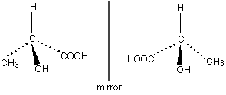
Why Some compounds are Optically Active
Compounds with tetrahedral structure in which four different groups are bonded to the central carbon.
Such a carbon becomes an asymmetric carbon, a chiral center or a stereogenic center.
Therefore optically active compounds are also chiral molecules.
These optical isomers that are related as an object is related to its mirror image are termed enantiomers

Slide 40
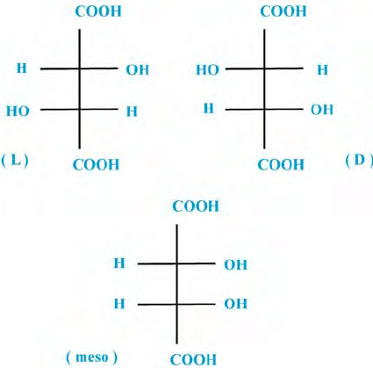
Some optically active compounds may have more than one isomers due to presence of several chiral carbons.
The number of optically active isomers a compound can have may be calculated as 2^{n} where n refers to the number of chiral centers
Lets take the case of tartaric acid as an example

Slide 41
Racemic Mixtures
These are equimolar mixtures of two optically active isomers
Such mixtures are optically inactive. Eg. (+)-lactic acid and (-)-Lactic acid when mixed in equal proportions gives a racemic mixture which is optically inactive.
Some biological systems are able to separate racemic mixtures. The separation of racemic mixtures is called Resolution.
Penicillium glaucum are able to utilize (+)-lactic acid but not the (-)-Lactic acid.

Slide 42
Properties of Enantiomers
The physical properties of enantiomers, like melting point, boiling point, density and solubility in common solvents are identical. However, the direction of plane polarized light differs.
Enantiomers form crystals of the same type except that one crystal is the mirror image of the other. The two are called enantiomorphs.
The chemical properties for enantiomers are identical for the reactions with compounds which are not optically active.
Enantiomers have different physiochemical properties. For example, (-) -adrenaline is more active in contracting blood capillaries than (+) -adrenaline. Then, (-) -nicotine is more poisonous than (+) -nicotine.

Slide 43
POLARIMETRY
Polarimety is the process of producing plane polarized light and finding the extent of rotation of the light by optically active compounds.
The polarimeter is used to measure polarity. It is comprised of the following components:
Light source: sodium lamp is commonly used. It produces a yellow light of wavelength 589.3nm (often called the D-line of sodium).
Polarizer: this could be a polaroid or Nicol prism. The light passes through the polarizer to produce a plane-polarized light.
Sample tube: holds the solution of the compound under investigation.
Analyzer: this is also a polaroid or Nicol prism. The light finally goes through the analyzer which rotates in order to obtain a reading on a scale attached to it.

Slide 44
The angle of rotation given by a solution depends on the:
Nature of the molecules
Concentration
Temperature
Wavelength of light
Type of solvent
The specific rotation can be calculated from the observed rotation, which is measured in degrees (could be positive or negative), on the polarimeter.
The specific rotation is the amount of rotation given by 1.0gram of optically active sample in 1.0ml of solution in a polarimeter tube with a path length of 1.0dm at a specified temperature, wavelength, using a known solvent.
The specific rotation of a compound at 25 ℃, using the sodium D line can be calculated using the formula:

Slide 45
[α] ‣ ²⁵ = θ/l c
where [α] ‣ ²⁵ is the specific rotation of sodium D-line at 25 ℃
θ = observed rotation
l = length of polarimeter tube in decimeter (1 dm=10cm)
c = concentration of sample in g/ml

Slide 46
THANK YOU
15

